Slide 1

Java Workshop
Presenter:
Charles Cao, Founder of Service ECVictor Inc.
Sr. Software Development Engineer in Expedia
10+ Software development experience
Demon, Java Team lead of CGI
10+ Software development experience

Slide 2
Course Description
Java Course
  Advanced Java workshop -> Java Web Developer
  Automation Testing -> Automation Developer
Internship
  Java based program desgin
  Mostly backend

Slide 3
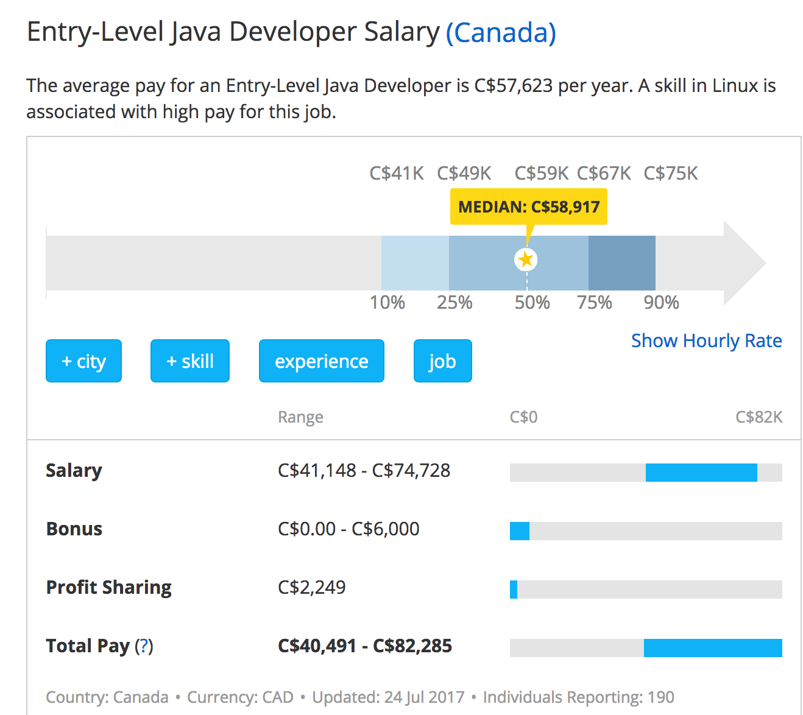
Salary Level Java Developer
http://www.payscale.com/research/CA/Job=Java_Developer/Salary/953cf2a1/Entry-Level

Slide 4

Entry-Level Quality Assurance (QA) / Test Automation Engineer
http://www.payscale.com/research/CA/Job=Test_%2f_Quality_Assurance_(QA)_Engineer_(Computer_Software)/Salary/d48da949/Entry-Level

Slide 5
System requirements
JDK 8 from Oracle
IntelliJ IDEA as IDE

Slide 6
Java platform overview
Java technology is used to develop applications for a wide range of environments, from consumer devices to heterogeneous enterprise systems.
The Java language is a C-language derivative, so its syntax rules look much like C's. For example, code blocks are modularized into methods and delimited by braces ({ and }), and variables are declared before they are used.

Slide 7
The JVM
At runtime, the JVM reads and interprets .class files and executes the program's instructions on the native hardware platform for which the JVM was written. The JVM interprets the bytecode just as a CPU would interpret assembly-language instructions.

Slide 8
Course Outline
Fundamental Programming
The main()
method Primitive Data
Types Variables
Constants
Assignments
Operators Strings
Control Flow
Initializations
Code Examples
& Exercises Classes & Objects

Slide 9
The Java Main Method
In Java, you need to have a method named main in at least one class. The following is what must appear in a real Java program.
public class MainExample {
public static void main(String[] args) {
String helloWorld = "Hello World!";
System.out.println(helloWorld);
}
}

Slide 10
Primitive Data Types
byte: The byte data type is an 8-bit signed two's complement integer.
short: The short data type is a 16-bit signed two's complement integer.
int: By default, the int data type is a 32-bit signed two's complement integer,
long: The long data type is a 64-bit two's complement integer.

Slide 11
Primitive Data Types
float: The float data type is a single-precision 32-bit IEEE 754 floating point.
double: The double data type is a double-precision 64-bit IEEE 754 floating point.
boolean: The boolean data type has only two possible values
char: The char data type is a single 16-bit Unicode character.

Slide 12
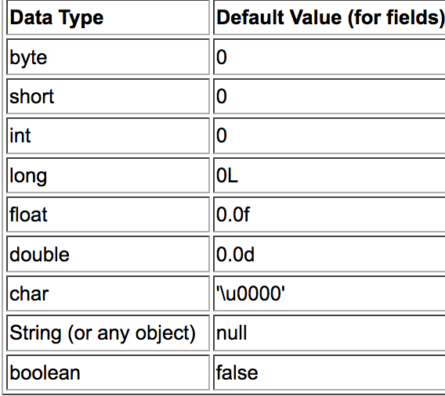
Default Values

Slide 13
Variables
As you learned in the previous lesson, an object stores its state in fields.
int cadence = 0;
int speed = 0;
int gear = 1;
Variable names are case-sensitive.
Subsequent characters may be letters, digits, dollar signs, or underscore characters.
If the name you choose consists of only one word, spell that word in all lowercase letters.

Slide 14
Constants
Java does not directly support constants. However, a static final variable is effectively a constant.
The static modifier causes the variable to be available without loading an instance of the class where it is defined. The final modifier causes the variable to be unchangeable.
e.g.
public static final int MAX_UNITS = 25;

Slide 15
Assignment, Arithmetic, and Unary Operators
The Simple Assignment Operator
int cadence = 0; int speed = 0; int gear = 1;

Slide 16
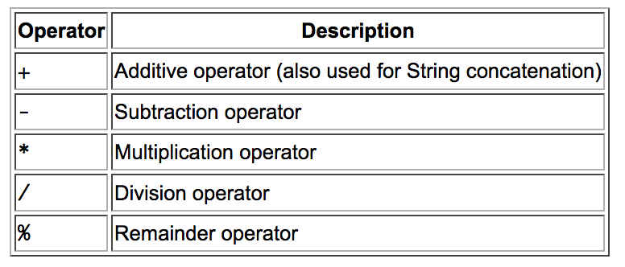
Assignments
The Arithmetic Operators

Slide 17
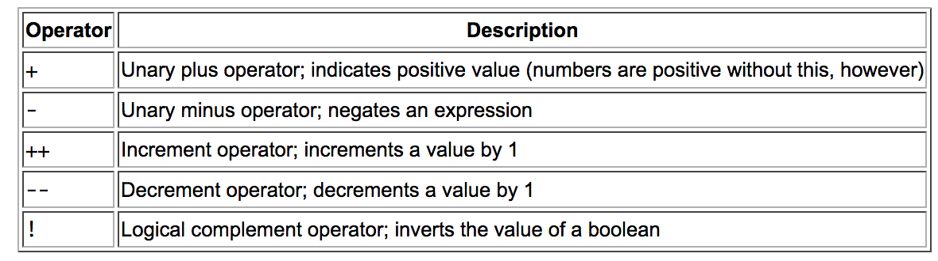
The Unary Operators

Slide 18
Strings
Creating
The most direct way to create a string is to write:
String greeting = "Hello world!";
As with any other object, you can create String objects by using the new keyword and a constructor. The String class has thirteen constructors that allow you to provide the initial value of the string using different sources, such as an array of characters:
char[] helloArray = { 'h', 'e', 'l', 'l', 'o', '.' };
String helloString = new String(helloArray); System.out.println(helloString);

Slide 19
String Length
String palindrome = "Dot saw I was Tod";
int len = palindrome.length();
Concatenating Strings
string1.concat(string2);
"Hello," + " world" + "!”
Such a concatenation can be a mixture of any objects. For each object that is not a String, its toString() method is called to convert it to a String.

Slide 20
Control Flow
The if-then Statement
if (isMoving){
// the "then" clause: decrease current speed currentSpeed--;
}
The if-then-else Statement
if (isMoving) {
currentSpeed--; }
else { System.err.println("The bicycle has already stopped!"); }

Slide 21
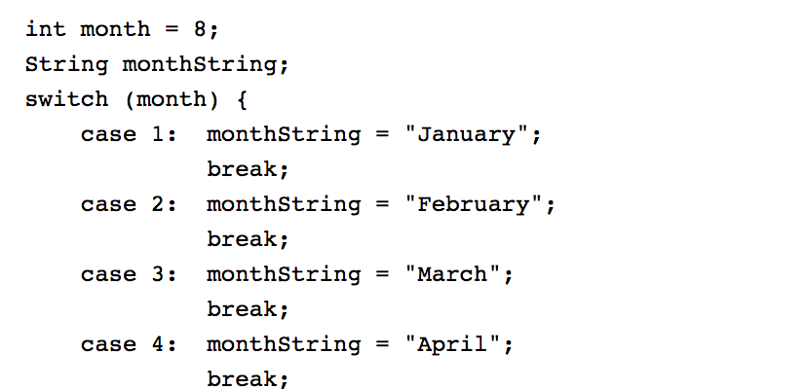
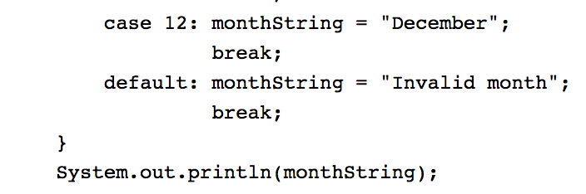
The switch Statement

Slide 22
Initializations
Initializing classes
class SomeClass {
static boolean b;
static byte by;
static char c;
static double d
}

Slide 23
Introducing class initialization blocks
A class initialization block is a block of statements preceded by the static keyword that's introduced into the class's body. When the class loads, these statements are executed

Slide 24
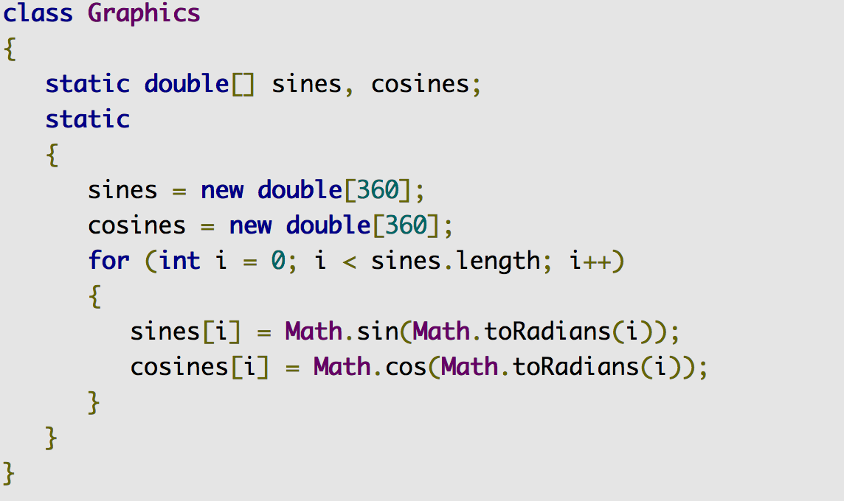
Introducing class initialization blocks

Slide 25
The while and do-while Statements
while (expression) { statement(s) }
do { statement(s) } while (expression);

Slide 26
The for Statement
for (initialization; termination; increment) { statement(s) }
for(int i=1; i<11; i++){
System.out.println("Count is: " + i);
}

Slide 27
Classes and Objects in Java
Instance Variables
Class Variables
Constructors
Instance Methods
Class Methods
OOP Principles
Instantiation
Encapsulation
Specialization

Slide 28


Classes and Objects in Java
Declaring Classes

Slide 29
Declaring Member Variables
public modifier—the field is accessible from all classes.
private modifier—the field is accessible only within its own class.
In this lesson, be aware that the same naming rules and conventions are used for method and class names, except that
the first letter of a class name should be capitalized, and
the first (or only) word in a method name should be a verb.

Slide 30
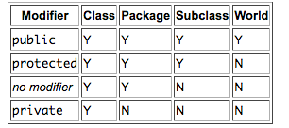
Access Levels

Slide 31
Defining Methods
public double calculateAnswer(double wingSpan, int numberOfEngines,
double length, double grossTons) {
//do the calculation here
}
The signature of the method declared above is:
calculateAnswer(double, int, double, double)

Slide 32
Naming a Method
Although a method name can be any legal identifier, code conventions restrict method names. By convention, method names should be a verb in lowercase or a multi-word name that begins with a verb in lowercase, followed by adjectives, nouns, etc. In multi-word names, the first letter of each of the second and following words should be capitalized. Here are some examples:
run runFast getBackground getFinalData

Slide 33
static variable
In Java Variables can be declared with the “static” keyword.
Example: static int y = 0;
When a variable is declared with the keyword static, its called a class variable. All instances share the same copy of the variable. A class variable can be accessed directly with the class, without the need to create a instance.

Slide 34
No “static” Keyword = Instance Variables
Without the static keyword, it’s called instance variable, and each instance of the class has its own copy of the variable.
It is a variable which belongs to the class and not to object(instance)
Static variables are initialized only once , at the start of the execution . These variables will be initialized first, before the initialization of any instance variables
A single copy to be shared by all instances of the class
A static variable can be accessed directly by the class name and doesn’t need any object
Syntax : <class-name>.<variable-name>

Slide 35
Static Methods
t is a method which belongs to the class and not to the object(instance) A static method can access only static data. It can not access non-static data (instance variables) A static method can call only other static methods and can not call a non-static method from it. A static method can be accessed directly by the class name and doesn’t need any object Syntax: <class-name>.<method-name> A static method cannot refer to this or super keywords in anyway

Slide 36
static block
The static block, is a block of statement inside a Java class that will be executed when a class is first loaded into the JVM.

Slide 37
instantiation
In programming, instantiation is the creation of a real instance or particular realization of an abstraction or template such as a class of objects or a computer process.

Slide 38
Instance Methods
a method is not declared static then it's an instance method.
A static method belongs to the class itself and a non-static (i.e instance) method belongs to each object that is generated from that class.

Slide 39
Constructors
A class contains constructors that are invoked to create objects from the class blueprint. Constructor declarations look like method declarations—except that they use the name of the class and have no return type. For example, Bicycle has one constructor:

Slide 40
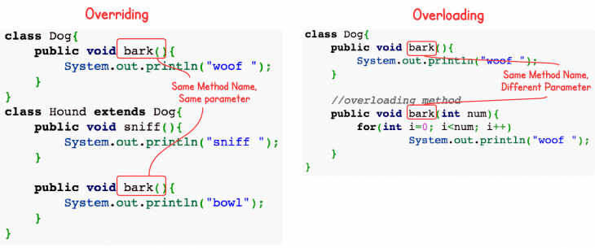
Overloading vs overriding java

Slide 41
Overriding vs. Overloading
The real object type in the run-time, not the reference variable's type, determines which overridden method is used at runtime. In contrast, reference type determines which overloaded method will be used at compile time.
Polymorphism applies to overriding, not to overloading.
Overriding is a run-time concept while overloading is a compile-time concept.

Slide 42
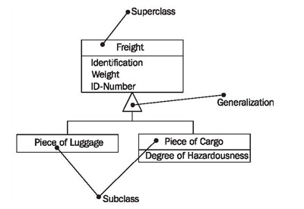
Generalization, Specialization, and Inheritance

Slide 43
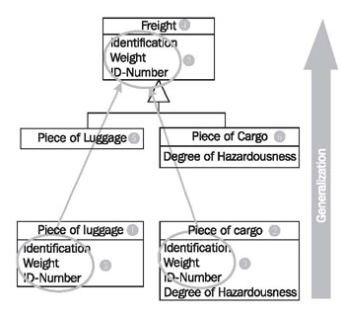
Generalization

Slide 44
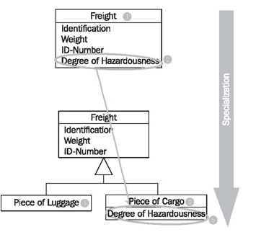
Example of specialization

Slide 45
OOP Principles
Encapsulation
Inheritance
Polymorphism

Slide 46
Encapsulation
Encapsulation means putting together all the variables (instance variables) and the methods into a single unit called Class.
It also means hiding data and methods within an Object. Encapsulation provides the security that keeps data and methods safe from inadvertent changes.

Slide 47
Inheritance
A class that is derived from another class is called a subclass (also a derived class, extended class, or child class). The class from which the subclass is derived is called a superclass (also a base class or a parent class).
Excepting Object, which has no superclass, every class has one and only one direct superclass (single inheritance). In the absence of any other explicit superclass, every class is implicitly a subclass of Object.

Slide 48
Polymorphism
In Core, Java Polymorphism is one of easy concept to understand. Polymorphism definition is that Poly means many and morphos means forms.

Slide 49
What You Can Do in a Subclass
The inherited fields can be used directly, just like any other fields.
You can declare a field in the subclass with the same name as the one in the superclass, thus hiding it (not recommended).
You can declare new fields in the subclass that are not in the superclass.
The inherited methods can be used directly as they are..

Slide 50
You can write a new instance method in the subclass that has the same signature as the one in the superclass, thus overriding it.
You can write a new static method in the subclass that has the same signature as the one in the superclass, thus hiding it.
You can declare new methods in the subclass that are not in the superclass.
You can write a subclass constructor that invokes the constructor of the superclass, either implicitly or by using the keyword super

Slide 51
Nested Classes
The Java programming language allows you to define a class within another class. Such a class is called a nested class and is illustrated here:
class OuterClass { ... class N
estedClass { ... } }

Slide 52
Why Use Nested Classes?
It is a way of logically grouping classes that are only used in one place: If a class is useful to only one other class, then it is logical to embed it in that class and keep the two together. Nesting such "helper classes" makes their package more streamlined.
It increases encapsulation: Consider two top-level classes, A and B, where B needs access to members of A that would otherwise be declared private. By hiding class B within class A, A's members can be declared private and B can access them. In addition, B itself can be hidden from the outside world.

Slide 53
It can lead to more readable and maintainable code: Nesting small classes within top-level classes places the code closer to where it is used.

Slide 54
Private Members in a Superclass
A subclass does not inherit the private members of its parent class. However, if the superclass has public or protected methods for accessing its private fields, these can also be used by the subclass.
A nested class has access to all the private members of its enclosing class—both fields and methods. Therefore, a public or protected nested class inherited by a subclass has indirect access to all of the private members of the superclass.

Slide 55
Using the this Keyword
The most common reason for using the this keyword is because a field is shadowed by a method or constructor parameter.
public class Point {
public int x = 0;
public int y = 0;
//constructor
public Point(int a, int b) { x = a; y = b; }
}

Slide 56
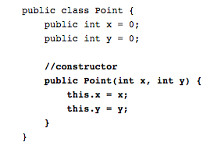

Slide 57
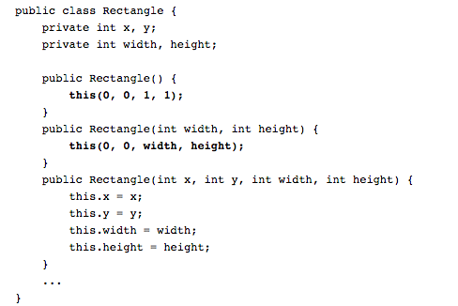

Slide 58
Java Memory Management
Object creation is faster because global synchronization with the operating system is not needed for every single object. An allocation simply claims some portion of a memory array and moves the offset pointer forward. The next allocation starts at this offset and claims the next portion of the array.
When an object is no longer used, the garbage collector reclaims the underlying memory and reuses it for future object allocation. This means there is no explicit deletion and no memory is given back to the operating system.

Slide 59
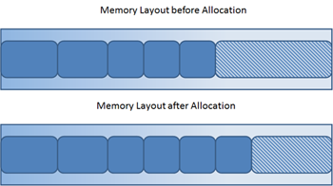

Slide 60
All objects are allocated on the heap area managed by the JVM. Every item that the developer uses is treated this way, including class objects, static variables, and even the code itself. As long as an object is being referenced, the JVM considers it alive. Once an object is no longer referenced and therefore is not reachable by the application code, the garbage collector removes it and reclaims the unused memory. As simple as this sounds, it raises a question: what is the first reference in the tree?

Slide 61
Garbage-Collection Roots—The Source of All Object Trees
Local variables are kept alive by the stack of a thread. This is not a real object virtual reference and thus is not visible. For all intents and purposes, local variables are GC roots.
Active Java threads are always considered live objects and are therefore GC roots. This is especially important for thread local variables.

Slide 62
Static variables are referenced by their classes. This fact makes them de facto GC roots. Classes themselves can be garbage-collected, which would remove all referenced static variables. This is of special importance when we use application servers, OSGi containers or class loaders in general. We will discuss the related problems in the Problem Patterns section.
JNI References are Java objects that the native code has created as part of a JNI call. Objects thus created are treated specially because the JVM does not know if it is being referenced by the native code or not. Such objects represent a very special form of GC root, which we will examine in more detail in the Problem Patterns section below.

Slide 63
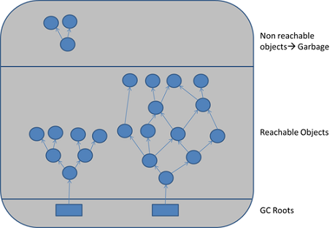

Slide 64
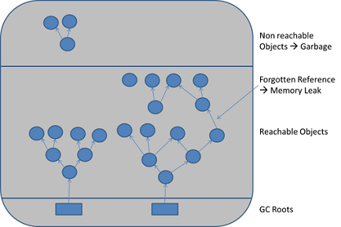
Marking and Sweeping Away Garbage

Slide 65
Garbage collection
When you specify the startup option -Xmx on the command line of your Java application (for instance: java -Xmx:2g MyApp) memory is assigned to a Java process. This memory is referred to as the Java heap (or just heap).
This is the dedicated memory address space where all objects created by your Java program (or sometimes the JVM) will be allocated. As your Java program keeps running and allocating new objects, the Java heap (meaning that address space) will fill up.

Slide 66
A garbage collection can also be triggered when a Java program calls System.gc(). Using System.gc() does not guarantee a garbage collection.
Reference counting collectors
  Reference counting collectors keep track of how many references are pointing to each Java object.
Tracing collectors
  Tracing collectors are based on the assumption that all live objects can be found by iteratively tracing all references and subsequent references from an initial set of known to be live objects.

Slide 67
Associations
The association relationship indicates that a class knows about, and holds a reference to, another class. Associations can be described as a "has-a" relationship because the typical implementation in Java is through the use of an instance field. The relationship can be bi-directional with each class holding a reference to the other. Aggregation and composition are types of association relationships.

Slide 68
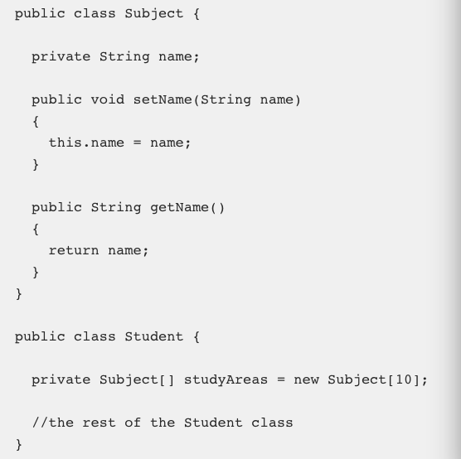
Aggregation

Slide 69
Delegates
When an object receives a request, the object can either handle the request itself or pass the request on to a second object to do the work. If the object decides to pass the request on, you say that the object has forwarded responsibility for handling the request to the second object.

Slide 70
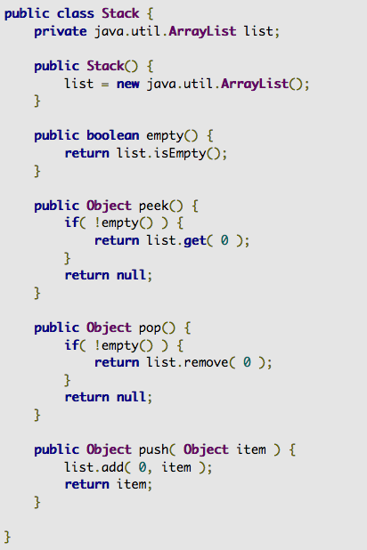

Slide 71
Interfaces
An interface is a reference type in Java. It is similar to class. It is a collection of abstract methods. A class implements an interface, thereby inheriting the abstract methods of the interface.
Along with abstract methods, an interface may also contain constants, default methods, static methods, and nested types. Method bodies exist only for default methods and static methods.

Slide 72
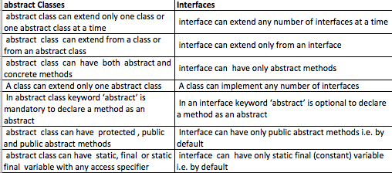
Interface vs. abstract class

Slide 73
Java Exception Handling
Advantages of Exceptions
  Advantage 1: Separating Error-Handling Code from "Regular" Code
  Advantage 2: Propagating Errors Up the Call Stack
  Advantage 3: Grouping and Differentiating Error Types

Slide 74
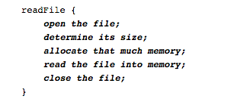
Separating Error-Handling Code from "Regular" Code

Slide 75
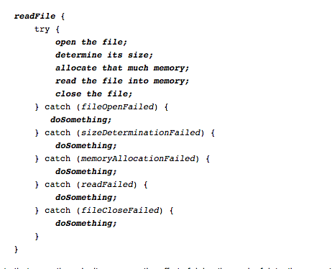

Slide 76
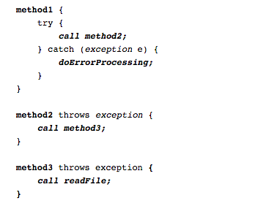
Propagating Errors Up the Call Stack

Slide 77
Grouping and Differentiating Error Types
catch (IOException e) {
// Output goes to System.err.
e.printStackTrace();
// Send trace to stdout. e.printStackTrace(System.out);
}

Slide 78
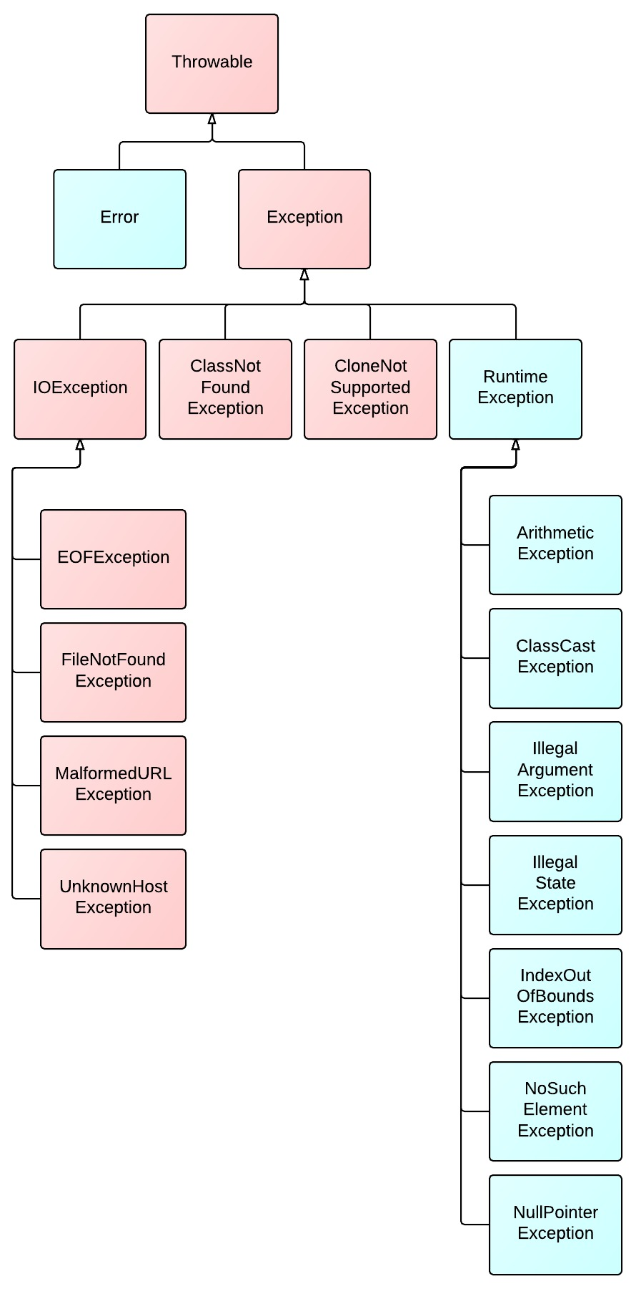
Diagram of Exception Hierarchy

Slide 79
Checked vs. Unchecked Exceptions
Checked exceptions:
  represent invalid conditions in areas outside the immediate control of the program (invalid user input, database problems, network outages, absent files)
  are subclasses of Exception
  a method is obliged to establish a policy for all checked exceptions thrown by its implementation (either pass the checked exception further up the stack, or handle it somehow)

Slide 80
Unchecked exceptions
represent defects in the program (bugs) - often invalid arguments passed to a non-private method. To quote from The Java Programming Language, by Gosling, Arnold, and Holmes: "Unchecked runtime exceptions represent conditions that, generally speaking, reflect errors in your program's logic and cannot be reasonably recovered from at run time."
are subclasses of RuntimeException, and are usually implemented using IllegalArgumentException, NullPointerException, or IllegalStateException
a method is not obliged to establish a policy for the unchecked exceptions thrown by its implementation (and they almost always do not do so)

Slide 81
Is the NumberFormatException consider a checked exception?
No. NumberFormatException is unchecked (= is subclass of RuntimeException). Why? I don't know. (but there should have been a method isValidInteger(..))
Is RuntimeException an unchecked exception?
Yes, exactly.
Why do people add class Exception in the throws clause?
Most often because people are lazy to consider what to catch and what to rethrow. Throwing Exception is a bad practice and should be avoided.

Slide 82
System Exceptions vs. Application Exceptions
Any exception that is a subclass of Exception, but not a subclass of RuntimeException and RemoteException, is an application exception. All the application exceptions are checked exceptions, So, when we call another method in our method that can throw an application exception, we must either declare it in the throws clause of the calling method or catch it in the body of the calling method or both.
All system exceptions are unchecked exceptions except RemoteExceptions and it can't be handled by the user.

Slide 83
Writing Custom Exceptions
public class MyNewException extends RuntimeException { public MyNewException(){ super(); } public MyNewException(String message){ super(message); } }

Slide 84
Multithreading
A multi-threaded program contains two or more parts that can run concurrently and each part can handle a different task at the same time making optimal use of the available resources specially when your computer has multiple CPUs.

Slide 85
Processes and Threads
A process has a self-contained execution environment. A process generally has a complete, private set of basic run-time resources; in particular, each process has its own memory space.
Threads are sometimes called lightweight processes. Both processes and threads provide an execution environment, but creating a new thread requires fewer resources than creating a new process.
  Threads exist within a process — every process has at least one. Threads share the process's resources, including memory and open files. This makes for efficient, but potentially problematic, communication.

Slide 86
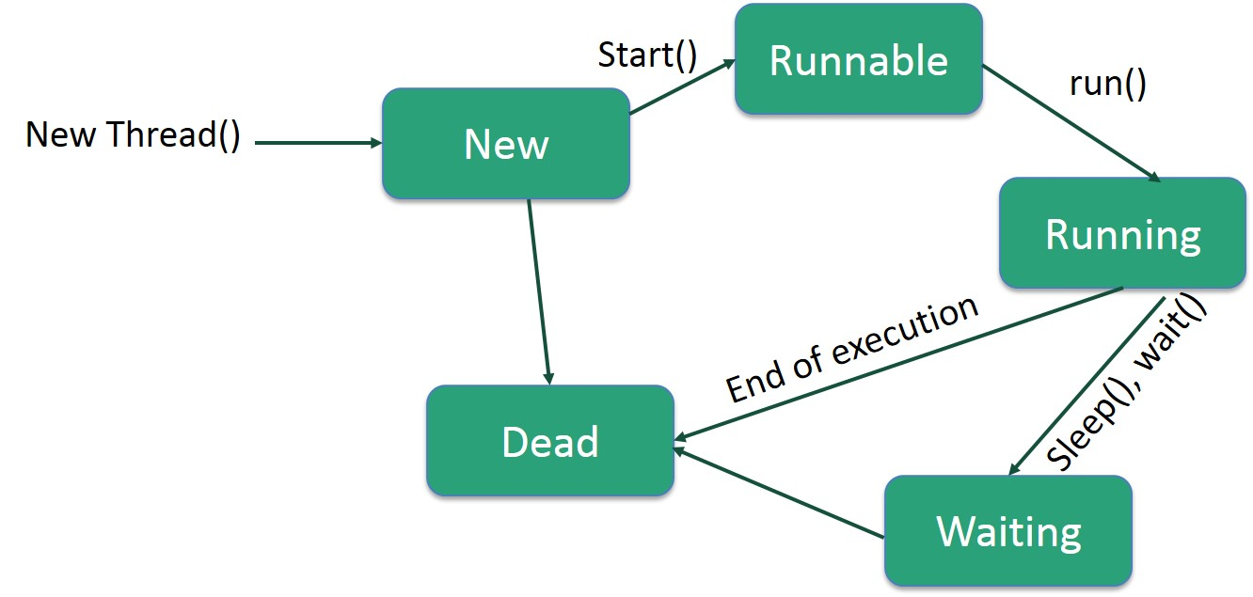
Life Cycle of a Thread

Slide 87
Collections

Slide 88
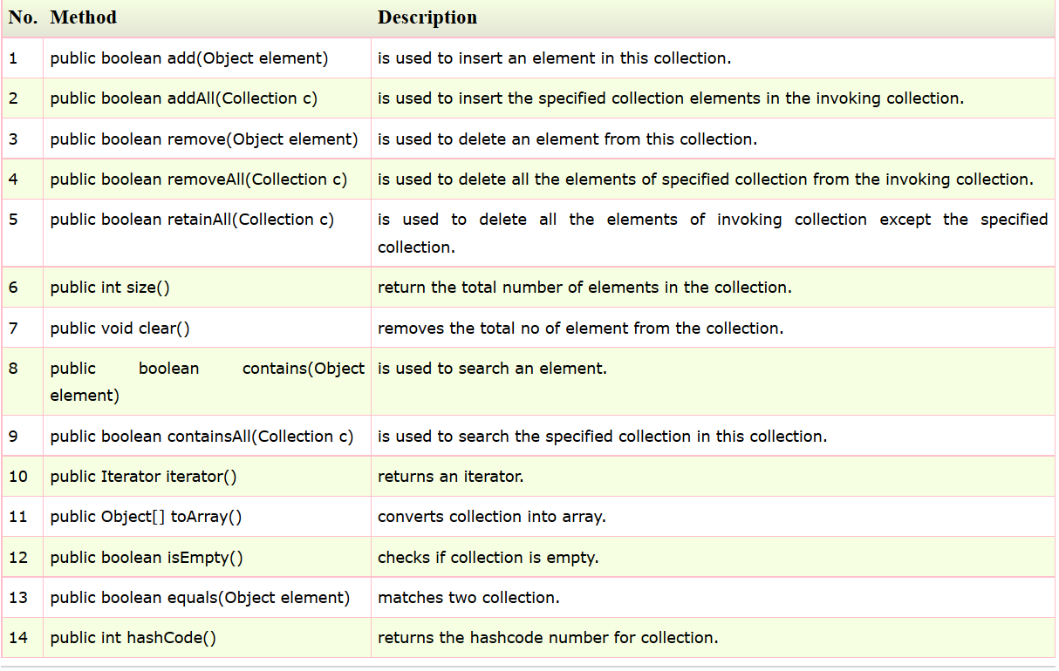
Methods of Collection interface

Slide 89
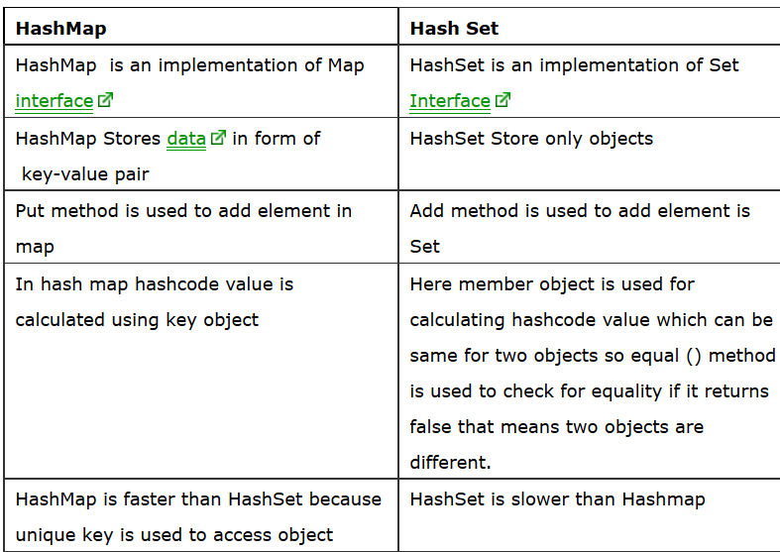
Hashmap vs hashset

Slide 90
ArrayList Vs LinkedList
1) Search: ArrayList search operation is pretty fast compared to the LinkedList search operation. get(int index) in ArrayList gives the performance of O(1) while LinkedList performance is O(n).
Deletion: LinkedList remove operation gives O(1) performance while ArrayList gives variable performance: O(n) in worst case (while removing first element) and O(1) in best case (While removing last element).

Slide 91
3) Inserts Performance: LinkedList add method gives O(1) performance while ArrayList gives O(n) in worst case. Reason is same as explained for remove.

Slide 92
Memory Overhead: ArrayList maintains indexes and element data while LinkedList maintains element data and two pointers for neighbor nodes hence the memory consumption is high in LinkedList comparatively.

Slide 93
Questions?
THANK YOU!
MERCI!

